Slide 1
DETECTING MALICIOUS NETWORK ACTIVITY BY USING MACHINE LEARNING ON REAL WORLD TRAFFIC DATA

Slide 2
Problem statement and definitions
Detecting Malicious Network Activity Using Machine Learning on real world traffic data:
This topic is the algorithm to identify malicious activity in network traffic data instead of predefined rules ML models learn patterns from labeled dataset to detect new unknown threats.

Slide 3
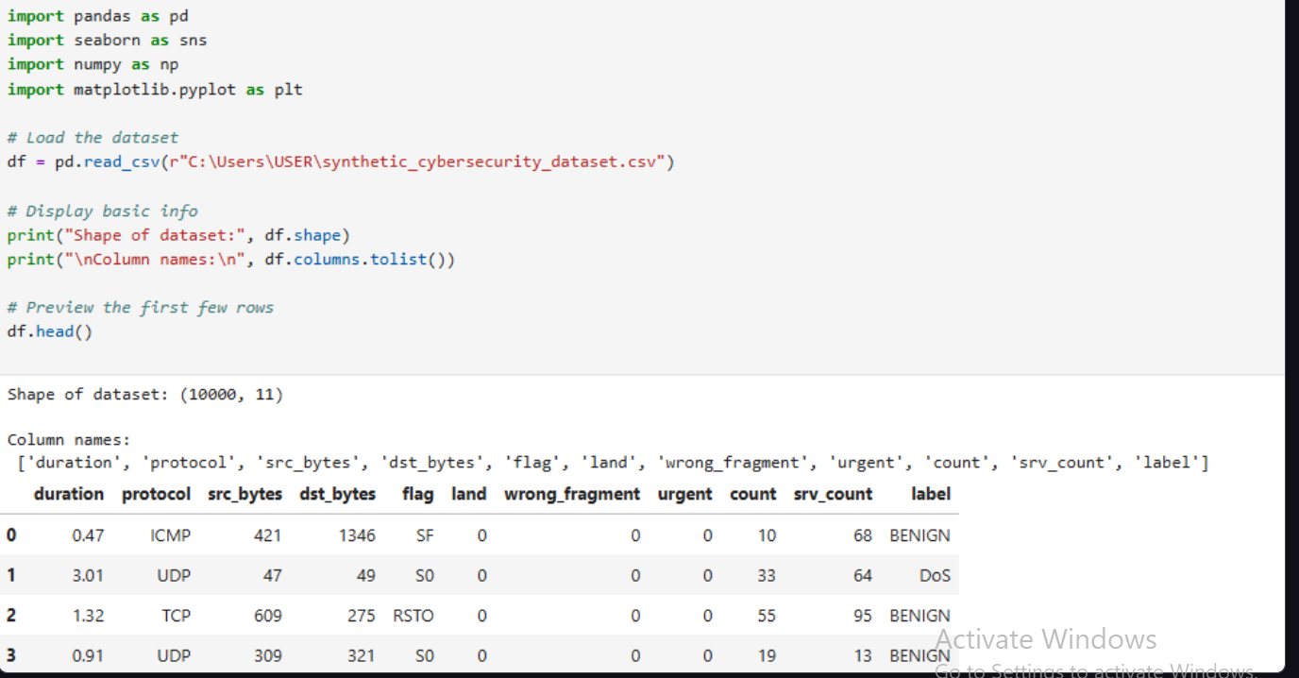
DATA LOAD
This shows the codes used in loading the dataset and the output.

Slide 4
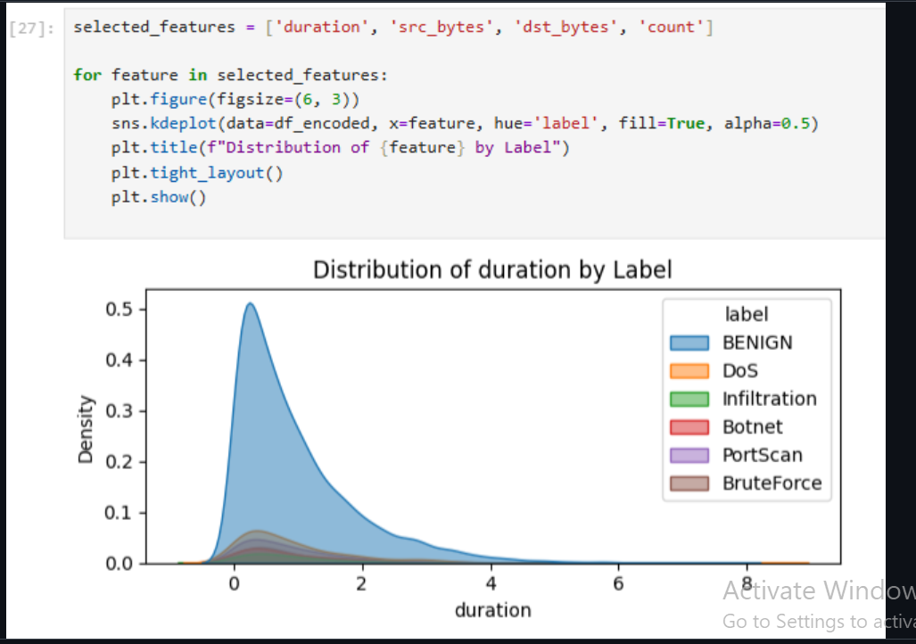
Distribution of Duration by Label
This is the output of the distribution it takes to minimize the density of it.

Slide 5
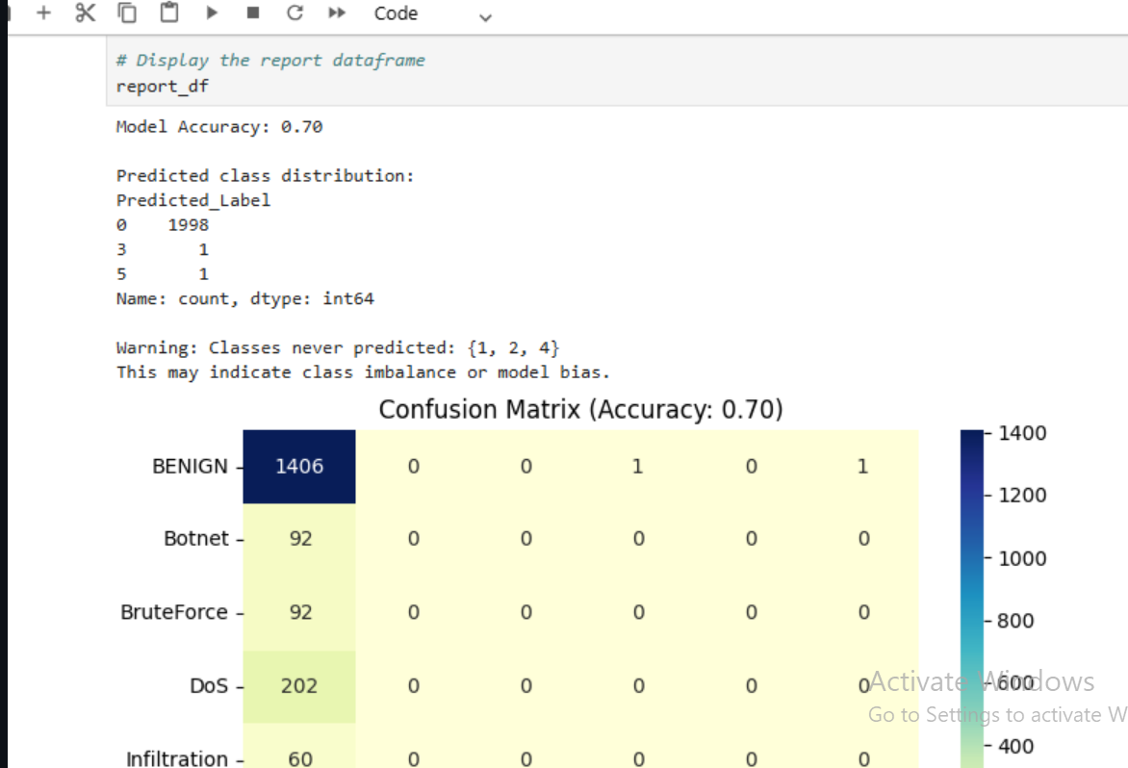
Confusion matrix(Accuracy)
This is the report of the data frame of this dataset.

Slide 6
CONCLUSION
This is the summary of my work I have done so far the other a lot of work are on my Github if you get time you can visit.
Link to my github: https://github.com/Kwizerasandrine/FinalProject.git
Done By : Kwizera Sandrine
ID: 26104

